Slide 1
Advanced C++ Internals: Chapter 18: C++ Scope and Lifetimes
ZACOCPPINT

Slide 2
Learning Journey:
Types of Association
Scope
Limiting Scope to Translation-unit
Lifetime
Lab #29
Scope and Lifetimes from a coding perspective
Lab #30
Scope and Lifetimes from a reverse engineering perspective
Summary
Appendices:
Useful links
Learning Outcomes:
Must be able to describe the importance of scope and lifetimes
Should be able to identify and use scope and lifetimes appropriately
Could be able to identify the impact of scope and lifetimes in memory
C++ Scope and Lifetimes

Slide 3
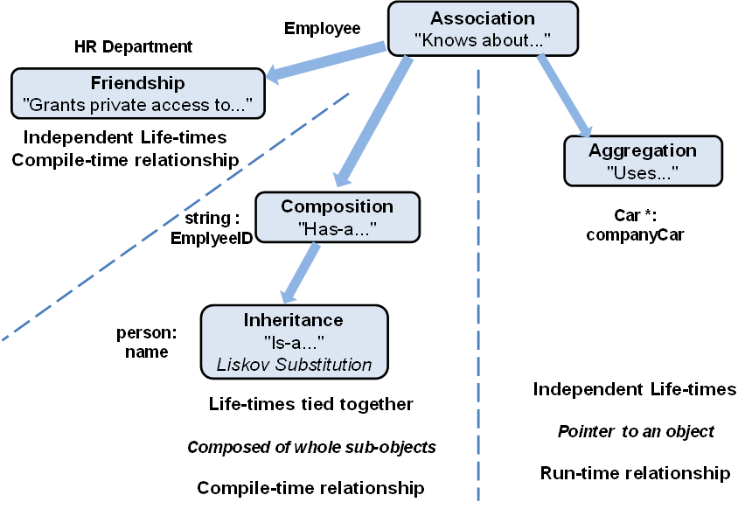
Types of Association
Fig 18.1 Different Association Types
Notes:
Why is this concept important for understanding scope, visibility and lifetime of names in C++?
In C++, association types refer to the ways in which identifiers (such as variables, functions, or classes) are associated or linked with specific scopes.
Scope is simply the area of a program where an identifier is accessible and valid, and association types define just how (and where) these identifiers are tied to different scopes.
Understanding these different association types helps you manage the visibility and lifetime of names in C++, principally because we gain an understanding of how they are actually used (and fit “together”).

Slide 4

Scope = Visibility of names
Constrained by { }
:: Global Scope
Namespace Scope
Function Scope
Class Scope
Brace (or block) scope
Scope
extern int sharedGlobal; // some other TU defines this global
Notes:
Files do not create scope in C++.
Global-entities may be accessed from other files with a simple forward-declaration.
`extern` is how we forward-declare variables.
Function and class forward declarations do not need a keyword.

Slide 5
namespace {
variables
functions
class definitons
typedefs
using declarations
}
static auto myVar = Widget{};
static void foo();
Limiting Scope to Translation-unit
Anonymous namespace gives local-linkage
No entry in Symbol Table
cannot be ‘extern ‘
Prefer anonymous namespace to ‘ static‘
Notes:
A translation unit is simply the basic source code “entity” that is processed by a compiler.
It typically consists of: Source code, i.e. cpp files plus the contents of all the header files (directly or indirectly) included.

Slide 6
Lifetime = Persistence of values…
This depends on their storage location
Stack
Static storage
Heap
Lifetime
Notes:
In simplest terms:
Stack – local variables and function call information; usually a limited lifetime (e.g. function scope), automatically “popped” when function exits.
Static storage – used for global and static variables; lifetime spans the entire program execution – deallocated when program terminates
Heap – dynamic memory allocation at runtime; not determined by scope – usually managed explicitly by software engineer (new, delete etc.); can cause memory leaks etc.

Slide 7
Default location for arguments and local variables
fast and efficient
values destroyed at closing brace
automatic clean-up
Lifetime is the same as scope
Stack Variables

Slide 8
Global variables
- including inside namespaces
- whether marked as static or not
Class static variables
Function static variables
Placed by compiler/linker
V. Fast & efficient (next allocation is obvious)
Should not be used to hide dependencies (modifying globals inside a function)
Lifetime from process-set-up to process-clean-up
Static Variables

Slide 9
static-storage variables must be defined, as well as declared
Can inline in .h instead:
extern int myGlobal;
class Baz {
// This is only a forward-declaration
static int _baz_static;
};
Inline Static Variables
// .cpp file
int myGlobal = 10;
Baz::_baz_static = 20;
inline extern int myGlobal = 10;
class Baz {
inline static int _baz_static = 20;
};
Notes:
A Class definition is simply a collection of forward-declarations.
The function-prototypes forward declare the functions.
The data-members are also forward-declarations. They announce "If someone ever bothers to create an object of this type, it will contain the following data..."
Class static data members are likewise forward declarations, so require a definition as well.

Slide 10
Classically…
Created by new
Destroyed by delete
However…
Slower to allocate
Slower to access
Possibility of undefined behaviour due to programmer error (bugs)
Lifetime determined by programmer
it often goes wrong…
Heap Variables
int* myVar = new int; // Allocation on heap
// use it...
delete myVar; // Deallocate to avoid memory leak
Notes:
In modern C++, the use of new and delete for dynamic memory management is generally discouraged in favour of using smarter and safer alternatives provided by the Standard Library and modern C++ features.
This includes automatic memory management, as exemplified by smart pointers.
We’ll look at these later.

Slide 11
Object type | Object location | Object lifetime
function local | Stack | Code-block
‘new object’ | Heap | Until ‘delete object’
globals function static class static data | Static storage* | Process start to termination
constexpr & literals | Code
Process Memory Layout
Notes:
The C++ Programming Language text by C++ creator Stroustrup, states that the data segment (DS) is specifically reserved for global and static variables.
Generally, we say that initialised static variables are stored in the initialised data segment of the executable, whilst uninitialized static variables are placed in the BSS (Block Started by Symbol) sub-segment and are set to 0 at run-time, before the program starts.

Slide 12
Function arguments are evaluated before the function call in any order
Each function-call creates a stack-frame (activation-record) on the stack containing:
the calling-point address
the function arguments
space for local variables
Execution jumps to the function-code
When the function returns
writes the result at the calling-point address
deletes the local variables and the stack-frame
continues execution after the calling-point address
Stack Use

Slide 13
val = foo(baz); | stack
Evaluate baz Prepare stack | Create stack frame:
Push args Jump to foo code | addr: val arg: baz foo-locals:
foo returns | write result at val
stack unwound | foo-locals destructed stack-frame dropped
continues after val
Stack Use

Slide 14
C++ Internals Lab #29
Scope and Lifetimes (coding perspective)
Notes:
This lab focuses on using Scope and Lifetimes from a coding perspective

Slide 15
C++ Internals Lab #30
Scope and Lifetimes (reverse engineering perspective)
Notes:
This lab focuses on Scope and Lifetimes – from a reverse engineering perspective

Slide 16
Summary
Modern C++ uses the concepts of lifetime and scope to manage the visibility and existence of variables and objects.
Files do not create scope in C++
Scope is a term that refers to the region of program code where the variable is accessible and can be used, i.e.
Block, Function, Namespace, Class/Struct
Lifetime of an object refers to the period between its creation and destruction; when it is valid to use.
new and delete keywords can be very dangerous.
Modern C++ features including smart pointers etc. help to improve these aspects.

Slide 17
Any questions?

Slide 18
Appendices
Notes:
Some additional information you may find useful…

Slide 19
Websites and online resources
C++ Standard Library (no date) cppreference.com. Available at: https://en.cppreference.com/w/cpp/standard_library (Accessed: 16 November 2023).
JTC1/SC22/WG21 - The C++ Standards Committee - ISOCPP (no date) . Available at: https://www.open-std.org/jtc1/sc22/wg21/ (Accessed: 16 November 2023).
Useful resources

Slide 20
Review of Chapter’s Learning Outcomes

Slide 21
Learning Outcomes:
By the completion of this chapter, you…
Must be able to describe the importance of scope and lifetimes
Should be able to identify and use scope and lifetimes appropriately
Could be able to identify the impact of scope and lifetimes in memory
Please review these learning outcomes at chapter's end.
Learning Outcomes

